Slide 1
C# Fundamentals
Serialization (marshalling)

Slide 2
C# Language-Integrated Query Definition
Serialization is the process of converting an object into a stream of bytes in order to store the object or transmit it to memory, a database, or a file. Its main purpose is to save the state of an object in order to be able to recreate it when needed. The reverse process is called deserialization.

Slide 3
C# Language-Integrated Query Xml Serialization
XML serialization serializes the public fields and properties of an object, or the parameters and return values of methods, into an XML stream that conforms to a specific XML Schema definition language (XSD) document.
XML serialization results in strongly typed classes with public properties and fields that are converted to XML.
“System.Xml.Serialization” contains the classes necessary for serializing and deserializing XML.

Slide 4
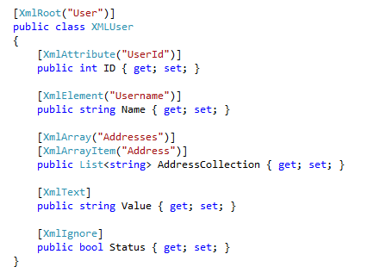
C# Language-Integrated Query Xml Serialization

Slide 5
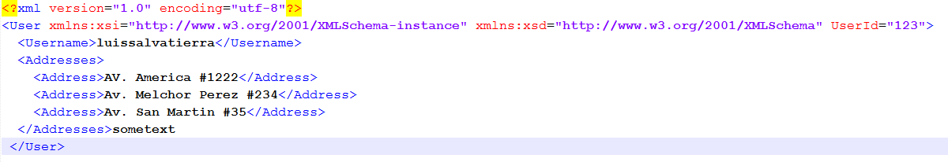
C# Language-Integrated Query Xml Serialization

Slide 6
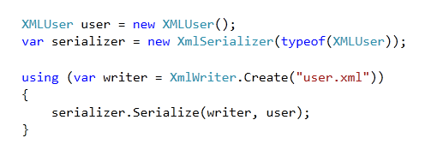
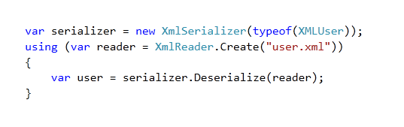
C# Language-Integrated Query Xml Serialization
Serialize
Deserialize

